Slide 1
Driver Drowsiness Detection System
Submitted in the partial fulfillment for the award of the degree of
BACHELOR OF ENGINEERING
IN
Computer Science with specialization in Artificial Intelligence and Machine Learning​
Submitted by:
Anusmriti Shome 19BCS6081
Pranav Garg 19BCS6067
Ritika Chopra 19BCS6071
Vishal Choudhary 19BCS6073
Aman Jain 19BCS6074
Under the Supervision of:
Dinesh Vij
Department of AIT-CSE
DISCOVER . LEARN . EMPOWER

Slide 2
Content
Introduction to Project
Problem Formulation
Related Work
Objectives of the work
Methodology used
Results and Outputs
Conclusion
Future Scope
References

Slide 3
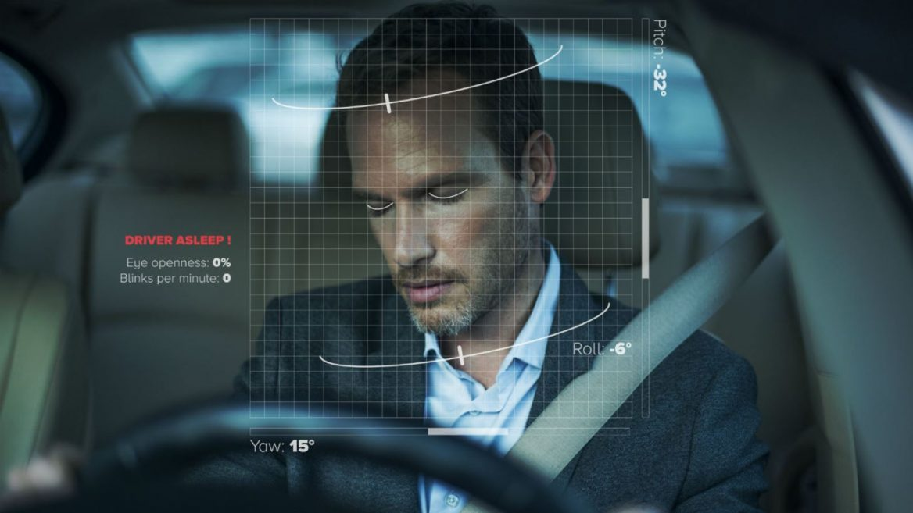
Introduction to Project
Sleeping is one of the basic needs of the human being. Lack of sleep can cause the body to react unproductively as well as ineffectively and because of this it can produce low alertness and loss of concentration.
Driver drowsiness detection System is a car safety technology which helps prevent accidents caused by the driver getting drowsy.
Various studies have suggested that around 20% of all road accidents are fatigue-related, up to 50% on certain roads.

Slide 4
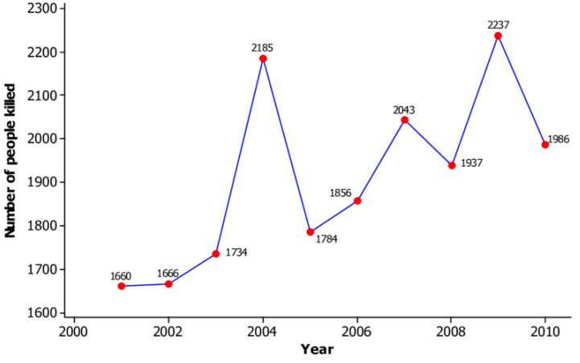
Problem Formulation
Every year the amounts of deaths and injuries are increasing in traffic accidents due to human errors. Drowsiness and driving are very hazardous. If the Driver fails to concentrate on driving it reduces the driver’s reaction time and impair steering behavior.

Slide 5
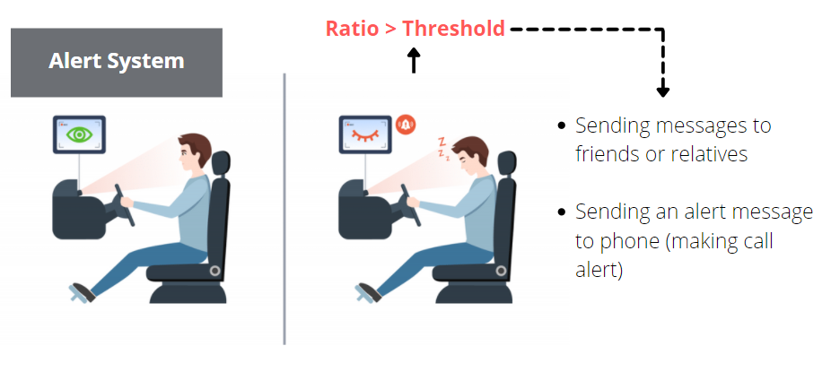
Problem Formulation
This model will be very effective solution in reducing road accidents. As with the help of this model, the driver will be easily altered. The sensor observes the movements of the face and the eye and concludes whether the driver is getting drowsy or not.
The objective of this intermediate neural network project is to build a drowsiness detection system that will detect that a person’s eyes are closed for a few seconds. This system will alert the driver when drowsiness is detected.

Slide 6
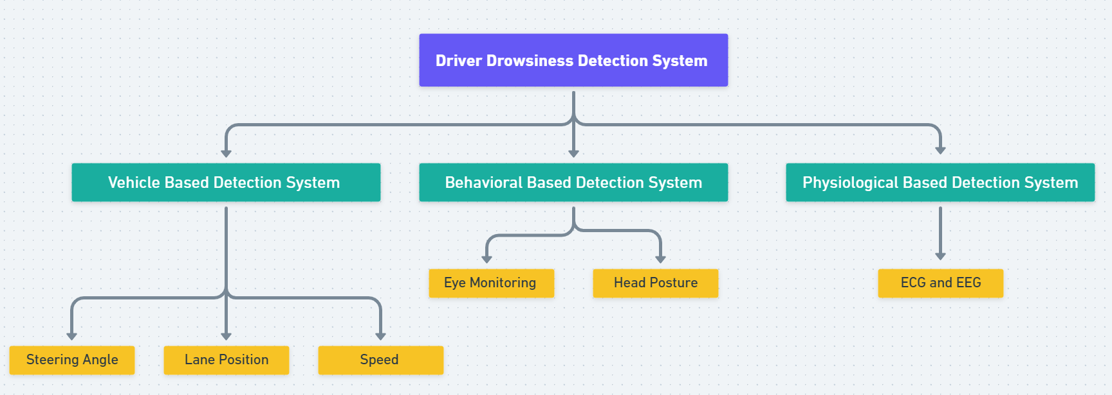
Existing Work

Slide 7

Proposed Work
The proposed detection system that we have made deals with Deep learning algorithms as well as the DLib library to detect and predict the results. Also, an alert system is added to this application to alert the driver if he/she is feeling drowsy.
We have used high enhanced face tracking algorithm which can make the prediction more accurate. It uses 68 face landmarks to detect facial feature. Detecting the facial feature using 68 landmarks is more accurate and precise than the PERCLOS and HAAR cascading algorithm.

Slide 8
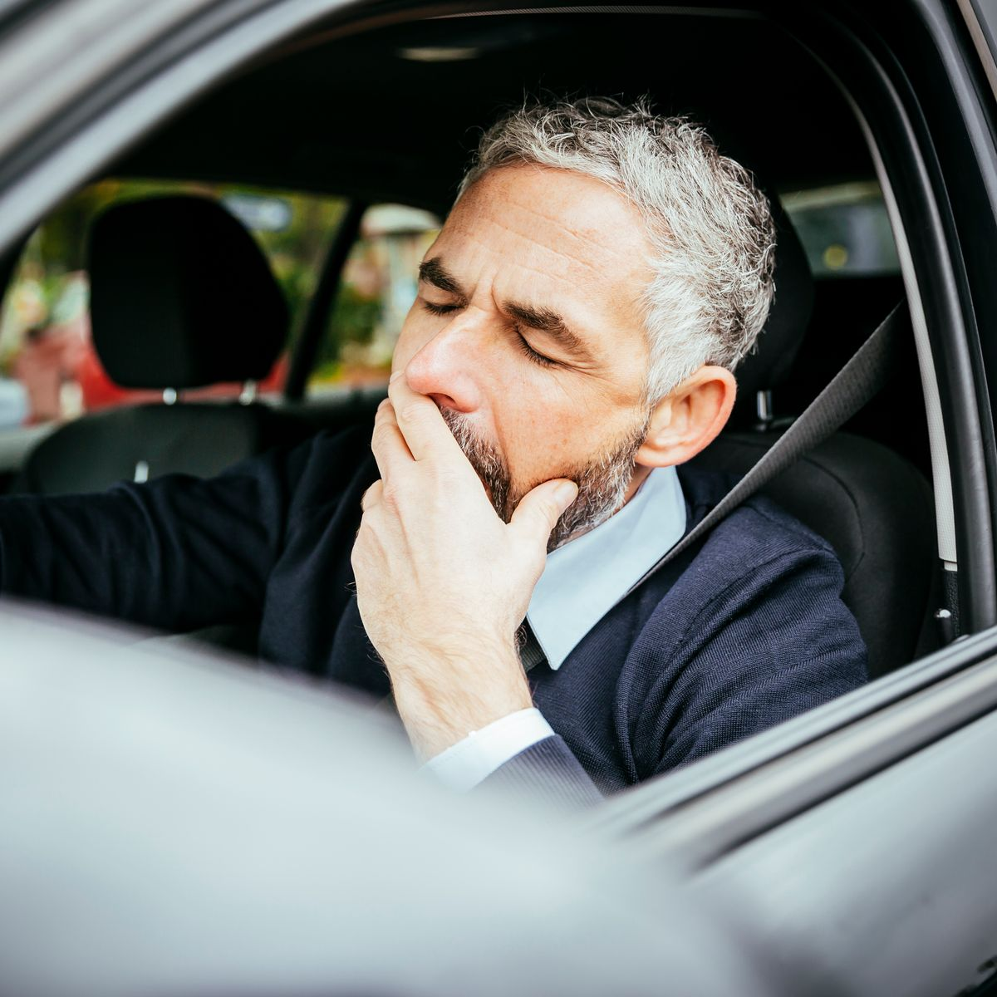
Objectives
The main objectives of this proposed model are mentioned below:
To suggest ways to detect fatigue and drowsiness while driving and to investigate the physical changes of fatigue and drowsiness.
To develop a detective system that can be used to observe the eyes’ closure and yawning as a way to detect fatigue and drowsiness.
To analyze the data obtained by the detective device and to develop an algorithm for yawning detection to monitor driver fatigue level.
To create an alarm system that will use the prediction of the deep learning algorithm to alert the driver if the driver fatigue level detected by the model is higher than a certain level.

Slide 9
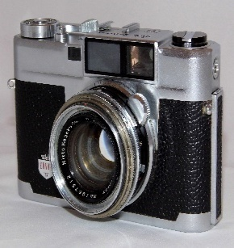
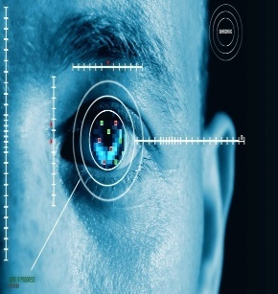
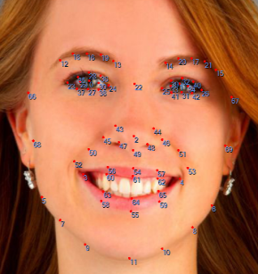
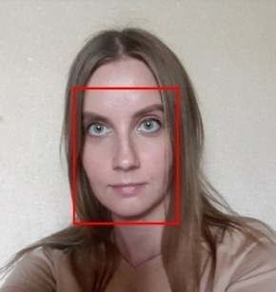
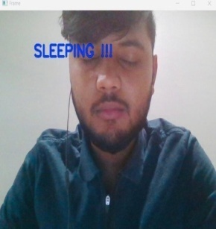
Methodology used
This model uses the enhanced library that is written in the python programming language.
OpenCV, as well as DLib libraries, are mainly used to formulate the solution for Image acquisition.
Deep learning algorithms are used to detect the facial features that will be responsible for calculating the output value.
At last, an alert system is connected to the software to alert the driver if he/she is feeling drowsy. The application needs to follow certain steps to predict the desired outcome.
External Camera
Image Acquisition
Facial Feature Tracking
Detection Stage
Alert System

Slide 10
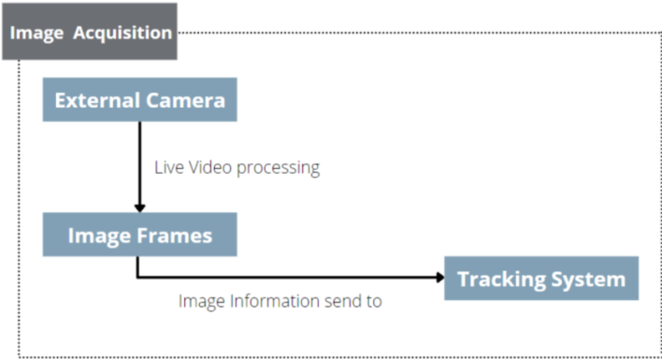
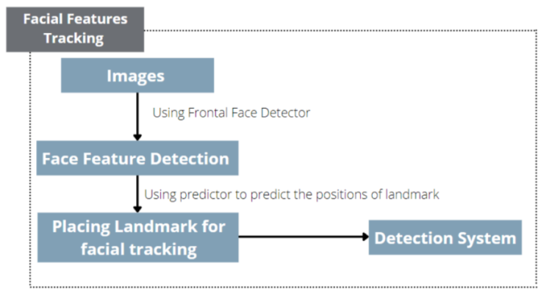
Contd.
IMAGE ACQUISITION The model will be using the OpenCV framework for image acquisition. It is used to intake the live video that will be captured using an external camera which is embedded with the following algorithm.
FACIAL FEATURES TRACKING After that, the acquired image frames are fed into different modules such as the Facial tracking systems and detection systems. These systems have integrated the DLib module which has pre-implemented ML algorithms.

Slide 11
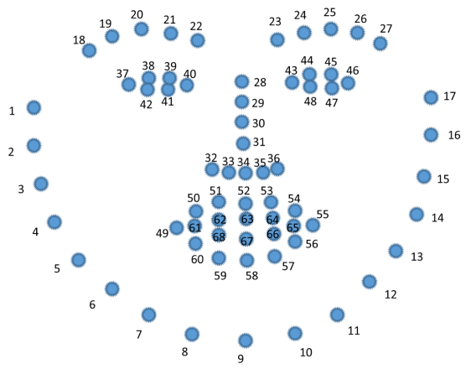
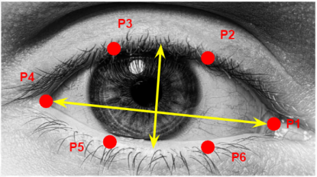
Contd.
These libraries build a Face_recognition model for our application. The Face_recognition model uses a deep learning algorithm with an accuracy of 99.38%. Face_recognition has built-in functions to perform face detection, recognition, and identification tasks. First, it will load the image into a NumPy array and apply the face_landmarks function. It uses the shape predictor 68 landmark dataset to detect the facial features.
Face_landmarks function returns a list of all faces in the image. Each face is further having a ‘name’ and ‘list of points’ for all facial features of the face. It will use the OpenCV library to track the facial features and inbuilt DLib function to detect the face and then apply algorithms to accurately predict all 68 Landmark points in the face.

Slide 12
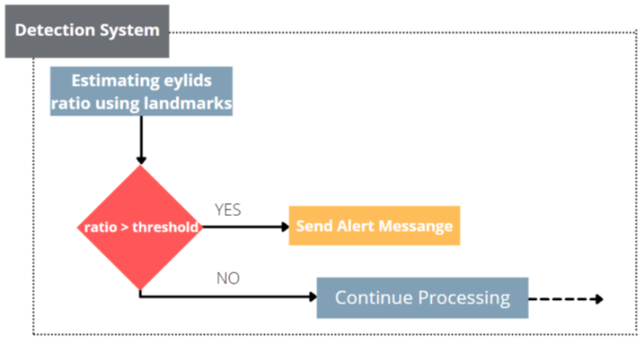
Contd.
DETECTION SYSTEM After a lot of research by Scientists, they have concluded that the ratio between 0.21 and 0.25 is considered to be in the Drowsed state. Using this ratio we will set a threshold value and if the driver’s drowsiness crosses this value, the alarm system will alert the driver.
In the alert system, it will use the SMTP module which will send an alert email message to the driver’s family member and close friend. The model can be extended where we can generate emergency calls.

Slide 13
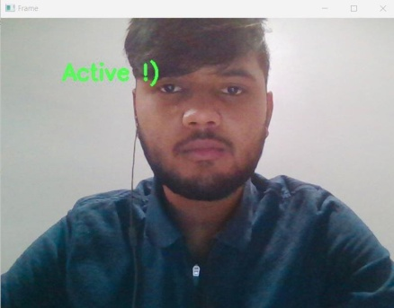


Results and Outputs
The whole program can be embedded in an external camera system that will record all the live data of the facial feature and based on the recorded data the result of the system will be determined. The facial features tracking system will set all the facial landmarks and the detection system will compare all the calculated values with the threshold value. If the calculated value is greater than the threshold, it will send a message to the alert system.
The alert system after receiving the message will send an alert message through emails.

Slide 14
Conclusion
We developed a driver’s drowsiness detection, alarm and a novel semi-automatic parking system to prevent road crashes. In addition, we extended the work to report the nearby police station of the occurrence. We used slow waves to fast waves ratio for detecting drowsiness as it is more reliable to detect drowsiness than any single wave. We processed the signals in Dlib Library and implemented a model of the rest of the system in real time which worked successfully. If this proposed system is implemented with the legislation of proper traffic rules, it would hopefully reduce the rate of devastating road crashes.
Conclusion

Slide 15
References
[1] Kyong Hee Lee, Whui Kim, Hyun Kyun Choi, Byung Tae Jan. “A Study on Feature Extraction Methods Used to Estimate a Driver’s Level of Drowsiness”, IEEE, February 2019.
[2] Tianyi Hong, Huabiao Qin, “Drivers Drowsiness Detection in Embedded System.”, IEEE, December 2007.
[3] Lorraine Saju, Christeena J, Farhana Yasmin, Surekha Mariam, “Drowsiness detection system for drivers using HAART training and template matching”, IJEAST, Vol. 1, Issue 6, April 2016.
[4] Dwipjoy Sarkar, Atanu C, “Real-Time Embedded System Application for Driver Drowsiness and Alcoholic Intoxication Detection”, IJETT, Volume 10 Number 9, April 2014.
[5] SrinivasuBatchu, S Praveen Kumar, “Driver Drowsiness Detection to Reduce the Major Road Accidents in Automotive Vehicles”, IRJET, Volume 02 Issue 01, April 2015.
[6] Hardeep Singh, J S Bhatia and Jasbir Kaur, “Eye Tracking based Driver Fatigue Monitoring and Warning System”, IEEE, January 2011.

Slide 16
Contd.
[7] Fouzia, Roopalakshmi R, Jayantkumar A Rathod, Ashwitha S, Supriya K, “Driver Drowsiness Detection System Based on Visual Features.”, IEEE, April 2018.
[8] Varsha E Dahiphale, Satyanarayana R, “A Real-Time Computer Vision System for Continuous Face Detection and Tracking”, IJCA, Volume 122 Number 18, July 2015.
[9] SaeidFazli, Parisa Esfahani, “Tracking Eye State for Fatigue Detection”, ICACEE, November 2012. Gao Zhenhai, Le DinhDat, Hu Hongyu, Yu Ziwen, Wu Xinyu, “Driver Drowsiness Detection Based on Time Series Analysis of Steering Wheel Angular Velocity”, IEEE, January 2017.
[10] Bagus G. Pratama, IgiArdiyanto, Teguh B. Adji, “A Review on Driver Drowsiness Based on Image, Bio-Signal, and Driver Behavior”, IEEE, July 2017.
[11] Sahayadhas A, Sundaraj K, Murugappan M. Detecting driver drowsiness based on sensors: a review [published correction appears in Sensors (Basel). 2021 Jan 11; 21(2):]. Sensors (Basel). 2012; 12(12):16937

Slide 17
Contd.
[11] Sahayadhas A, Sundaraj K, Murugappan M. Detecting driver drowsiness based on sensors: a review [published correction appears in Sensors (Basel). 2021 Jan 11; 21(2):]. Sensors (Basel). 2012; 12(12):16937-16953. Published 2012 Dec 7. Doi: 10.3390/s121216937
[12] B. Alshaqaqi, A. S. Baquhaizel, M. E. Amine Ouis, M. Boumehed, A. Ouamri and M. Keche, "Driver drowsiness detection system," 2013 8th International Workshop on Systems, Signal Processing and their Applications (WoSSPA), 2013, pp. 151-155, doi: 10.1109/WoSSPA.2013.6602353.
[13] M. A. Assari and M. Rahmati, "Driver drowsiness detection using face expression recognition," 2011 IEEE International Conference on Signal and Image Processing Applications (ICSIPA), 2011, pp. 337-341, doi: 10.1109/ICSIPA.2011.6144162.
[14] Sukrit Mehta, Sharad Dadhich, Sahil Gumber, Arpita Jadhav Bhatt (2019). Real Time Driver Drowsiness Detection System Using Eye Aspect Ratio and Eye Closure Ratio International Conference on Sustainable Computing in Science, Technology and Management.

Slide 18
THANK YOU

